Slide 1
Computer Organization
CS224
Spring 2011
Chapter 1b
With thanks to M.J. Irwin, D. Patterson, and J. Hennessy for some lecture slide contents

Slide 2
Performance
Measure, Report, and Summarize
Make intelligent choices
See through the marketing hype
Key to understanding underlying organizational motivation
Why is some hardware better than others for different programs?
What factors of system performance are hardware related?
(e.g., Do we need a new machine, or a new operating system?)
How does the machine's instruction set affect performance?

Slide 3

Which of these airplanes has the best performance?
Airplane Passengers Range (mi) Speed (mph)
Boeing 777 375 4630 610
Boeing 747 470 4150 610
BAC/Sud Concorde 132 4000 1350
Douglas DC-8-50 146 8720 544
How much faster is the Concorde compared to the 747?
How much bigger is the 747 than the Douglas DC-8?
Which airplane moves the most passengers in the least time?

Slide 4
Performance Metrics
Purchasing perspective
  given a collection of machines, which has the
    best performance ?
    least cost ?
    best cost/performance?
Design perspective
  faced with design options, which has the
    best performance improvement ?
    least cost ?
    best cost/performance?
Both require
  basis for comparison
  metric for evaluation
Our goal is to understand what factors in the architecture contribute to overall system performance and the relative importance (and cost) of these factors
Notes:
Or smallest/lightest
Longest battery life
Most reliable/durable (in space)

Slide 5
Computer Performance Measures
Response Time (latency)
— How long does it take for my job to run?
— How long does it take to execute a job?
— How long must I wait for the database query?
Throughput
— How many jobs can the machine run at once?
— What is the average execution rate?
— How much work is getting done?
If we upgrade a machine with a new processor what do we increase?
If we add a new machine to the lab what do we increase?

Slide 6
Execution Time
Elapsed Time
  counts everything (CPU, disk and memory accesses, I/O , etc.)
  a useful number, but often not good for comparison purposes
CPU time
  doesn't count I/O or time spent running other programs
  can be broken up into system time, and user time
Our focus: user CPU time
  time spent executing the lines of code that are "in" our program

Slide 7
Book's Definition of Performance
For some program running on machine X,
Performance_{X} = 1 / Execution time_{X}
"X is n times faster than Y"
Performance_{X} / Performance_{Y} = n
Problem:
  machine A runs a program in 20 seconds
  machine B runs the same program in 25 seconds
  How much faster is A than B? (25/20)

Slide 8
Performance Factors
Want to distinguish between total elapsed time and the time spent on our task
CPU execution time (CPU time) – time the CPU spends working on a task
  Does not include time waiting for I/O or running other programs
CPU execution time # CPU clock cycles
= x clock cycle time
for a program for a program
or
CPU execution time # CPU clock cycles for a program
= -------------------------------------------
for a program clock rate
Can improve performance by reducing either the length of the clock cycle or the number of clock cycles required for a program
Notes:
Many techniques that decrease the number of clock cycles also increase the clock cycle time

Slide 9
Review: Machine Clock Rate
Clock rate (MHz, GHz), CR, is inverse of clock cycle (CC) time (clock period)
CC = 1 / CR
one clock period
10 nsec clock cycle => 100 MHz clock rate
5 nsec clock cycle => 200 MHz clock rate
2 nsec clock cycle => 500 MHz clock rate
1 nsec clock cycle => 1 GHz clock rate
500 psec clock cycle => 2 GHz clock rate
250 psec clock cycle => 4 GHz clock rate
200 psec clock cycle => 5 GHz clock rate
Notes:
A clock cycle is the basic unit of time to execute one operation/pipeline stage/etc.

Slide 10
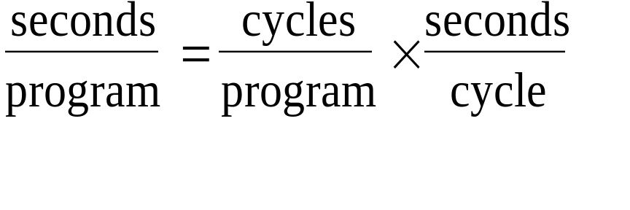
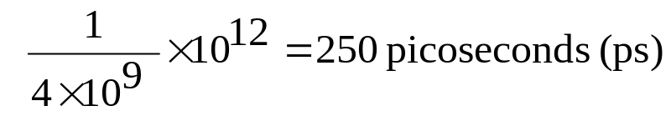
Clock Cycles
Instead of reporting execution time in seconds, we often use cycles
Clock “ticks” indicate when to start activities (one abstraction):
clock cycle time = time between ticks = seconds per cycle
clock rate (frequency) = cycles per second (1 Hz. = 1 cycle/sec)
A 4 Ghz. clock has a cycle time
time

Slide 11
How to Improve Performance
So, to improve performance (everything else being equal) you can either (increase or decrease?)
________ the # of required cycles for a program, or
________ the clock cycle time or, said another way,
________ the clock rate.

Slide 12
Big View of Performance
Computer
CPU
Devices
Memory
Control
Input
Datapath
Output
elapsed (response) time

Slide 13
System Performance
Computer
CPU
Memory
Devices
Control
Input
Datapath
Output
Throughput

Slide 14
Metrics of Performance
Transaction per day
Operations per second
Application
Programming
Language
Compiler
(millions) of Instructions per second – MIPS
(millions) of (F.P.) operations per second – MFLOP/s
ISA
Datapath
Control
Megabytes per second
Function Units
Transistors
Wires
Pins
Cycles per second (clock rate)

Slide 15
Processor Metrics
CPU clock cycles/pgm =
instructions/program * avg. clock cycles per instr. (CPI)
Execution time =
instruction/program * CPI * clock cycle time
CPI tells us something about the Instruction Set Architecture, the Implementation of that architecture, and the program measured.

Slide 16
How many cycles are required for a program?
Could assume that number of cycles equals number of instructions
1st instruction
3rd instruction
2nd instruction
4th
5th
6th
...
time
This assumption is incorrect, different instructions take different amounts
of time on different machines.
Why? [hint: remember that these are machine instructions, not lines of C code]

Slide 17
Different numbers of cycles for different instructions
time
Multiplication takes more time than addition
Floating point operations take longer than integer ones
Accessing memory takes more time than accessing registers
Important point: changing the cycle time often changes the number of cycles required for various instructions (more later)

Slide 18
Now that we understand cycles
A given program will require
  some number of instructions (machine instructions)
  some number of cycles
  some number of seconds
We have a vocabulary that relates these quantities:
  cycle time (seconds per cycle)
  clock rate (cycles per second)
  CPI (cycles per instruction)
  a floating point intensive application might have a higher CPI
  MIPS (millions of instructions per second)
  this would be higher for a program using simple instructions

Slide 19
Performance
Performance is determined by execution time!
Time = Seconds = Instructions x Cycles x Seconds
Program Program Instruction Cycle
Do any of the other variables equal performance?
  # of cycles to execute program?
  # of instructions in program?
  # of cycles per second?
  average # of cycles per instruction?
  average # of instructions per second?
Common pitfall: thinking one of the variables is indicative of performance when it really isn’t.

Slide 20
CPI Example
Suppose we have two implementations of the same instruction set architecture (ISA).
For some program,
  Machine A has a clock cycle time of 250 ps and a CPI of 2.0
  Machine B has a clock cycle time of 500 ps and a CPI of 1.2
  What machine is faster for this program, and by how much?
If two machines have the same ISA which of our quantities (e.g., clock rate, CPI, execution time, # of instructions, MIPS) will always be identical?

Slide 21
CPI Example (cont.)
Each computer executes the same number of instructions.
Let I denote the instruction count.
CPU clock cycles for machine A = I * 2
CPU clock cycles for machine B = I * 1.2
CPU time for A = CPU clock cycles * CC time = 500 * I ps
CPU time for B = CPU clock cycles * CC time = 600 * I ps
Computer A is faster
CPU performance of A / CPU performance of B = 1.2

Slide 22
The Performance Equation
Our basic performance equation is then
CPU time = IC x CPI x CC
- OR -
IC x CPI
CPU time = --------------------
CR
These equations separate the three key factors that affect performance
  Can measure the CPU execution time by running the program
  The clock rate is usually given
  Can measure overall instruction count by using profilers/ simulators without knowing all of the implementation details
  CPI varies by instruction type and ISA implementation for which we must know the implementation details
Notes:
Note that instruction count is dynamic – i.e., its not the number of lines in the code, but THE NUMBER OF INSTRUCTIONS EXECUTED

Slide 23
Clock Rate Example
Our favorite program runs in 10 seconds on computer A, which has a 4 GHz. clock. We are trying to help a computer designer build a new machine B, that will run this program in 6 seconds. The designer can use new (or perhaps more expensive) technology to substantially increase the clock rate, but has informed us that this increase will affect the rest of the CPU design, causing machine B to require 1.2 times as many clock cycles as machine A for the same program. What clock rate should we tell the designer to target?"
CPI_{B =} 1.2 * CPI_{A}
[ 10sec = (CPU clock cycles of A for program) / 4GHz ]
[ 6sec= (CPU clock cycles of B for program) / CR_{B}]
CR_{B} = 8GHz

Slide 24
Clock Rate != Performance
Mobile Intel Pentium 4 vs. Intel Pentium M
2.4 GHz 1.6 GHz
Performance on Mobilemark with same memory and disk
– Word, excel, photoshop, powerpoint, etc.
– Mobile Pentium 4 is only 1.15 times faster (15%)

Slide 25
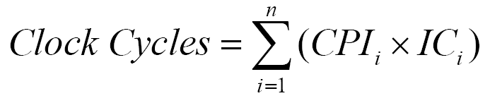
CPI Varies
Different instruction types require different numbers of cycles
CPI is often reported for types of instructions
where CPI_{i} is the CPI for the i type of instruction and IC_{i} is the count of that type of instruction

Slide 26
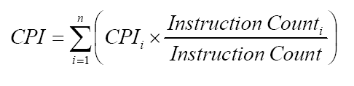
Computing CPI
To compute the overall average CPI, use
The CPI_{i} is obtained from the processor’s data sheet, and the instruction frequencies obtained by code profiling
Code profiling: running a software measurement tool in background, which counts instructions by type, as a program executes

Slide 27
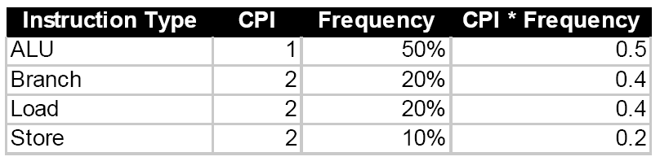
Computing CPI Example
Given this machine, the CPI is the sum of (CPI_{i} × Frequency_{i})
Average CPI is 0.5 + 0.4 + 0.4 + 0.2 = 1.5
What fraction of the time is spent for data transfers?
When considering where to try and improve performance, invest resources where the time is spent, i.e. make the common case fast!

Slide 28
Another CPI example: RISC processor
Op Freq Cycles CPI(i) %Time
ALU 50% 1 0.5 23%
Load 20% 5 1.0 45%
Store 10% 3 0.3 14%
Branch 20% 2 0.4 18%
▲ 2.2
Typical Mix
How much faster would the machine be if a better data cache
reduced the average load time to 2 cycles?
How does this compare with using branch prediction to shave a
cycle off the branch time?
What if two ALU instructions could be executed at once?

Slide 29
# of Instructions Example
A compiler designer is trying to decide between two code sequences for a particular machine. Based on the hardware implementation, there are three different classes of instructions: Class A, Class B, and Class C, and they require one, two, and three cycles (respectively).
The first code sequence has 5 instructions: 2 of A, 1 of B, and 2 of C
The second sequence has 6 instructions: 4 of A, 1 of B, and 1 of C.
Which sequence will be faster? How much?
What is the CPI for each sequence?

Slide 30
# of Instructions Example
A given application written in Java runs 15 seconds on a desktop processor. A new Java compiler is released that requires only 0.6 as many instructions as the old compiler. Unfortunately, it increases the CPI by 1.1.
How fast can we expect the application to run using this new compiler?

Slide 31
Design Trade-off
Fast Clock, Small CPI and Fewer Instructions
RISC: Reduced Instruction Set Computer
  each instruction does one simple operation
  easy to implement, less number of cycles per inst.
  more units in one chip and faster clock
  take more instructions per program
CISC: Complex Instruction Set Computer
  powerful instructions which do lots of work and take many cycles
  long cycle time, less number of instructions

Slide 32
MIPS example
Two different compilers are being tested for a 4 GHz. machine with three different classes of instructions: Class A, Class B, and Class C, which require one, two, and three cycles (respectively).
Both compilers are used to produce code for a large piece of software.
The first compiler's code uses 5 billion Class A instructions, 1 billion Class B instructions, and 1 billion Class C instructions.
The second compiler's code uses 10 billion Class A instructions, 1 billion Class B instructions, and 1 billion Class C instructions.
Which sequence will be faster according to MIPS?
Which sequence will be faster according to execution time?

Slide 33
Pitfall MIPS as Performance Metric
Instruction rate versus capabilities of the instructions
Different computers have different instruction sets with differing capabilities
MIPS varies between differing programs on the same machine.

Slide 34
Aspects of CPU Performance
CPU time = Seconds = Instructions x Cycles x Seconds
Program Program Instruction Cycle
instr. count CPI clock rate
Program
Compiler
Instr. Set Arch.
Organization
Technology
X
X
X
X
X
X
X
X

Slide 35
Benchmarks
Performance best determined by running a real application
  Use programs typical of expected workload
  Or, typical of expected class of applications
  e.g., compilers/editors, scientific applications, graphics, etc.
Small benchmarks
  nice for architects and designers
  easy to standardize
  can be abused
SPEC (System Performance Evaluation Cooperative)
  companies have agreed on a set of real program and inputs
  valuable indicator of performance (and compiler technology)
  can still be abused

